Slide 1
Writing Papers in the Biological Sciences
An introduction to Biological research and paper writing

Slide 2
Chapter Two: Handling Data and Using Statistics
Getting Started:
Start your research with questions leading to a specific prediction or hypothesis.
Identify the key variables so that you can plan your method of data analysis.
  Quantitative (numerical) versus Qualitative (nonnumerical)
  Ask questions and develop your hypothesis

Slide 3
How does your study fit the big picture?
  Does it build on other’s work?
  Don’t make the same mistakes
  In a science class lab setting, why are you doing this lab? (why is it important)

Slide 4
Key Variables
  Measurement variables
    Continuous: taking any value within a given range (e.g: abdomen length in bumblebees)
    Discontinuous: taking only integer values (number of leaves per zinnia plant).
    Ranked variables: includes ones that are ranked in order of magnitude, as in the case of the order of flowering (first, second, third, and so on; or 1, 2, 3, . . .) among a group of plants.
    Dependent variables: its value depends on (is affected by) the value of one or more independent variables (function of an independent one)
    Independent variables: opposed to dependent variables.

Slide 5
Independent Variable
The Independent part is what you, the experimenter, changes or enacts in order to do your experiment.

Slide 6
Dependent Variable
The dependent variable is what changes when the independent variable changes.
The dependent variable depends on the outcome of the independent variable.

Slide 7

Example
if you were measuring the growth rate of plants under full sunlight for 8 hours a day versus plants that only have 4 hours of full sunlight per day.
the amount of time per day of full sunlight would be the independent variable (the variable that you control).
The growth rate of the plants would be a dependent variable (the variable that you measure).

Slide 8
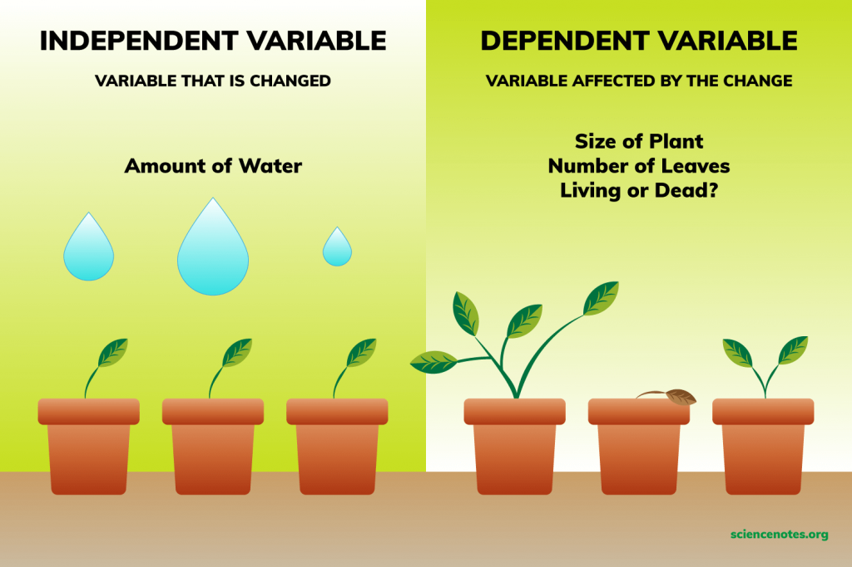
More clarification……

Slide 9
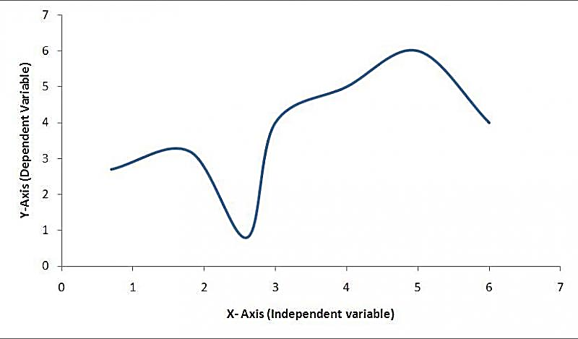
Variables in graph
Dependent variables go on y axis. Independent variables go on x axis.

Slide 10
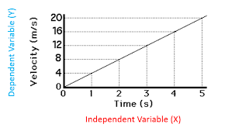
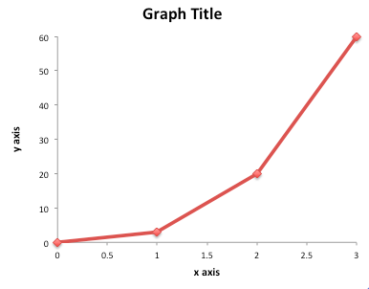
More clarification……
The independent variable belongs on the x-axis (horizontal line) of the graph and the dependent variable belongs on the y-axis (vertical line).

Slide 11
Experimental Control:
  What is the purpose of the control
  A control group allows a scientist to compare it to the other group or groups in an experiment.
  To Minimize influence of variables not being tested.
  to show what would normally happen and compare it with what happens when you change the independent variable.
  This shows if the independent variable is really responsible for your observations
  Test one variable at a time.

Slide 12
Randomness:
  Plant example in reading
  Don’t be biased - don’t choose your samples based on what you think is right. BE RANDOM!
  One way to ensure randomization is to number each plant at the beginning of the experiment and then use a table of random numbers to select the 10 plants to be harvested each time.

Slide 13
Recording and organizing your findings
  Data Sheets
    Be organized
    Have it ready to go
    Always include date/time
    Use Excel if you can (graphing and calculations)
    Don’t be afraid to slightly modify your data sheet
    Tips: (Few more suggestions about recording data)
      Write legibly
      Use PENCIL!
      Write comments or questions as you have them
      Keep your raw data sheets

Slide 14
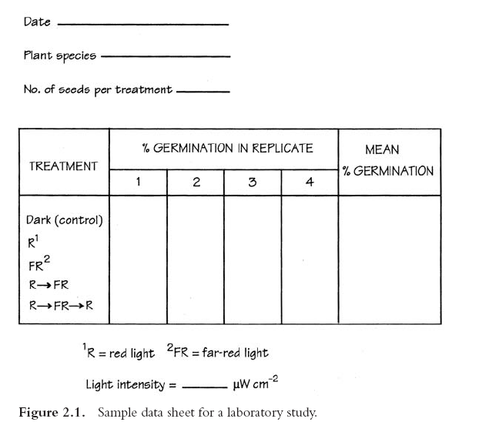

Slide 15
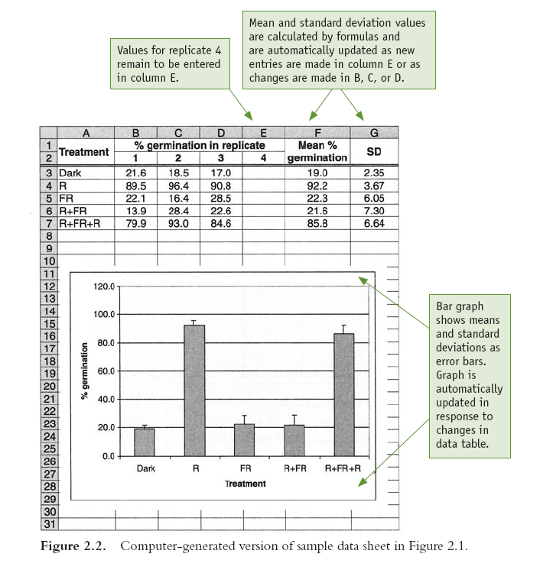

Slide 16
Using Statistics to Analyze your Data
  Make appropriate use of descriptive statistics.
  Descriptive statistics
    Mean (average) (mean X—)
    Standard deviation (symbolized s and abbreviated SD): which gives a sense of the variability of the data within a sample.
    the variance; its square root is the standard deviation.

Slide 17


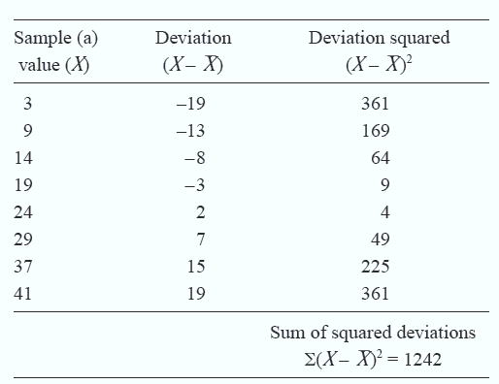

Slide 18
Range: The range is defined as the maximum minus the minimum value.
Standard Error: Certain measures derived from the standard deviation (SE).
Null Hypothesis: hypothesis of no difference, assumes that there is no difference among two or more populations from which samples have been drawn or no difference between results obtained and those expected.
Alternative Hypothesis: alternative hypothesis is the hypothesis used in hypothesis testing that is contrary to the null hypothesis.

Slide 19
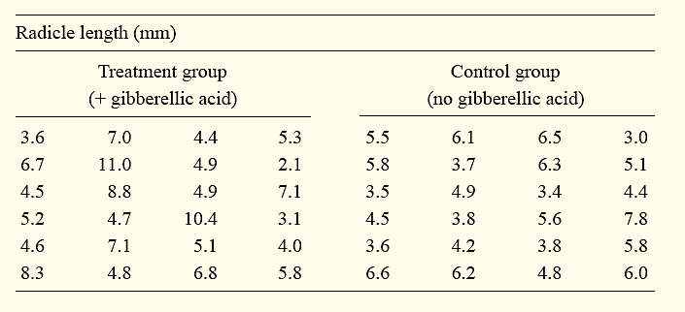
The null hypothesis : assumes that treatment with gibberellic acid has no effect; that is, that mean radicle lengths do not differ between populations of treated and untreated seeds.
The alternative hypothesis: is that a difference in mean radicle length does in fact exist.

Slide 20
The p-value relates to a test against the null hypothesis, usually that the parameter value is zero (no relationship).
The wider the confidence interval on a parameter estimate is, the closer one of its extreme points will be to zero, and a p-value of 0.05 means that the 95% confidence interval just touches zero.
p-value ≤0.05 ---significant, reject null.
p-value >0.05---not-significant, accept null.

Slide 21
Statistical analysis Software
Statistical software: are specialized computer programs for analysis in statistics and econometrics.
SPSS
Minitab
SAS
Statistica
MatLab
Much more!!!

